Slide 1

Time Series Prediction

Slide 2
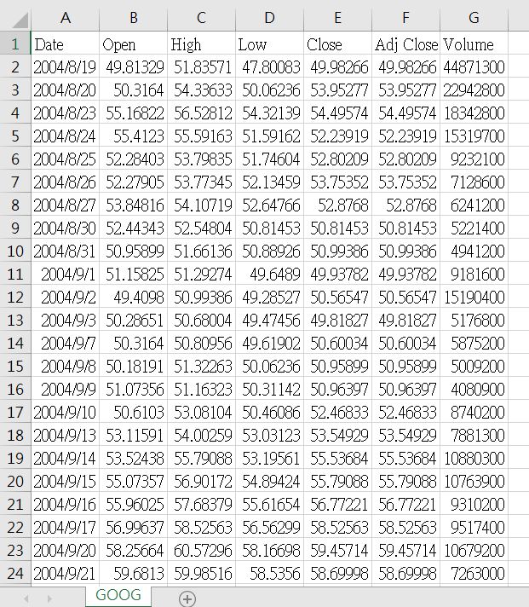
Stock Prices
Download from Yahoo! Finance or any other sources

Slide 3
Trends
Moving average
Long term trends (50 days)
Short term trends (200 days)
Value | Moving Avg
13
15
11 | (13+15+11)/3 = 13
12 | 12.67
13 | 12
10 | 11.67
10 | 11

Slide 4

Buy or Sell Signal
此相片 (作者: 未知的作者) 已透過 CC BY 授權

Slide 5
Predictions
Price
98.28162
96.59793
93.78846
90.02258
88.22929
94.26666
93.68883
94.81461
97.44476

Slide 6
Predictions
Day 1 | Day 2 | Day 3 | Day 4 (Prediction)
98.28162 1 | 96.59793 2 | 93.78846 3 | 90.02258 4
96.59793 2 | 93.78846 3 | 90.02258 4 | 88.22929 5
93.78846 3 | 90.02258 4 | 88.22929 5 | 94.26666 6
90.02258 | 88.22929 | 94.26666 | 93.68883
88.22929 | 94.26666 | 93.68883 | 94.81461
94.26666 | 93.68883 | 94.81461 | 97.44476
 | Price
1 | 98.28162
2 | 96.59793
3 | 93.78846
4 | 90.02258
5 | 88.22929
6 | 94.26666
7 | 93.68883
8 | 94.81461
9 | 97.44476
Notes:
Day123是X，Day4是Y，window size是3.

Slide 7
FIRST Simple Model
Task 1: Write a function that converts a sequence into X and Y for machine learning
Task 2: Compare the results with or without LSTM

Slide 8
Multiple Sequences In Prediction
 | Open | High | Low | Close | Volume
1 | 145.8782 | 146.0476 | 138.4809 | 139.258 | 51594400
2 | 141.8284 | 143.7113 | 139.7562 | 142.6204 | 33005300
3 | 142.9592 | 143.1036 | 139.4872 | 140.7225 | 25488200
4 | 139.3875 | 141.5644 | 137.7437 | 140.8471 | 25702300
5 | 138.7748 | 140.0949 | 138.3564 | 138.6553 | 20259300
6 | 136.9865 | 138.1322 | 133.2157 | 136.8869 | 41922600
7 | 136.6179 | 138.6304 | 136.0251 | 138.202 | 25018100
8 | 138.9791 | 139.6266 | 137.4349 | 139.6266 | 20946900
9 | 137.5295 | 143.2979 | 135.3577 | 142.8147 | 42206900

